Slide 1

Minimalism
part 1

Slide 2
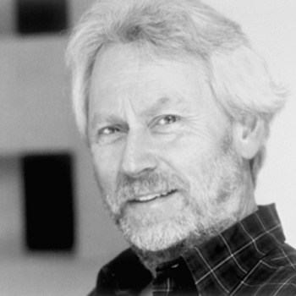
Donald Judd
Notes:
Donald Judd said in his essay "Specific Objects" in 1965 "Half or more of the best new work in the last few years has been neither painting nor sculpture. Usually it has been related, closely or distantly, to one or the other."

Slide 3
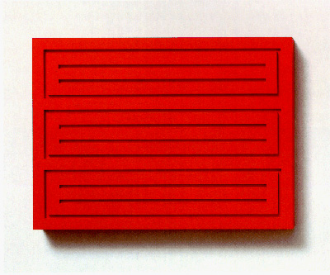
Notes:
Both an artist and an art critic, Judd set the stage for much of the way artwork in the 60s was viewed. Even though he, like many artists grouped under the name, distrusted the term 'Minimalism', he is often seen as the leading artist promoting the ideas behind the movement.

Slide 4
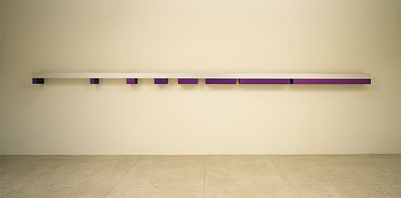
Notes:
The 60s and 70s brought about huge technological advances in factory produced materials, coatings and colors. Instead of focusing on the artist's personal hand, Judd saw this as an opportunity to make artworks that were planned with blueprints, and then manufactured in factories.

Slide 5
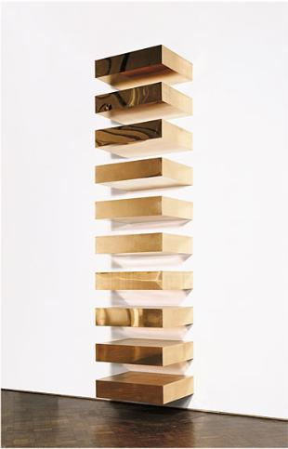
Notes:
Judd's work often makes use of repetition, but unlike the work coming out of Warhol's factory, Judd made clean, machine like units without imperfections.

Slide 6
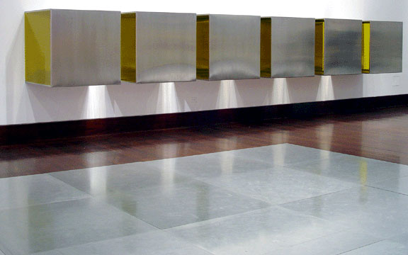
Notes:
Judd saw sculpture as being "made part by part, by addition, composed" just as we talked about the work of David Smith. In contrast, the new work, denies composition through balance and instead finds order through repetition and regularity.

Slide 7
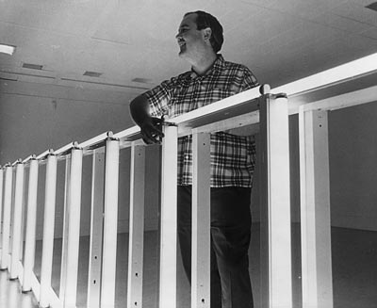
Dan Flavin
Notes:
Dan Flavin, a friend of Donald Judd, took much of Judd's philosophy to heart in his own work.

Slide 8
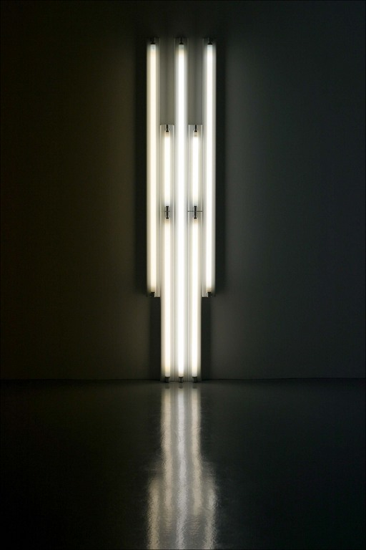
Notes:
Instead of having units manufactured according to his designs, he worked with standard florescent lighting fixtures arranging them into ordered compositions.

Slide 9
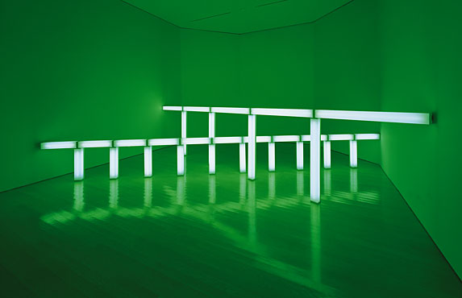
Notes:
The use of light allowed him to create pieces whose presence filled much more than just the physical space it occupied.

Slide 10
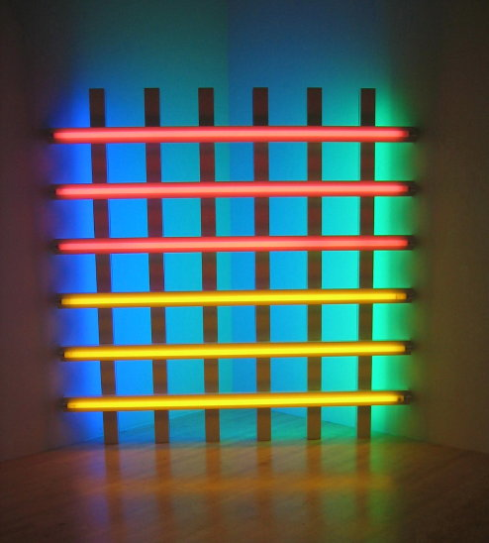
Notes:
By arranging colored lights, he was able to take color, usually a medium reserved for painters, and bring it into the realm of sculpture. Notice how the red and yellow bars here stand out against the blue and green ones reflecting off the wall behind. Think about how this works similarly to the push-pull of Hans Hoffman, and how it changes these principals by bringing color into three dimensions.

Slide 11
Images:
Donald Judd (1928 – 1994)
Woodblock, 1991
Untitled, 1964
Untitled, 1965
Untitled, 1966
Dan Flavin (1933 – 1996)
Untitled ( in honor Harold Joachim), 1977
Greens Crossing ( to Piet Mondrian who lacked green), 1966
Untitled ( to Jan and Ron Greenberg), 1972-3
Notes:
Donald Judd (1928 – 1994)
Woodblock, 1991
Untitled, 1964
Untitled, 1965
Untitled, 1966
Dan Flavin (1933 – 1996)
Untitled ( in honor Harold Joachim), 1977
Greens Crossing ( to Piet Mondrian who lacked green), 1966
Untitled ( to Jan and Ron Greenberg), 1972-3

